Slide 1

DATA ANALYTICS STEPS AND FIRST BUSINESS CASE

Slide 2



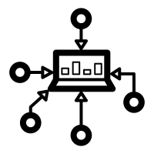




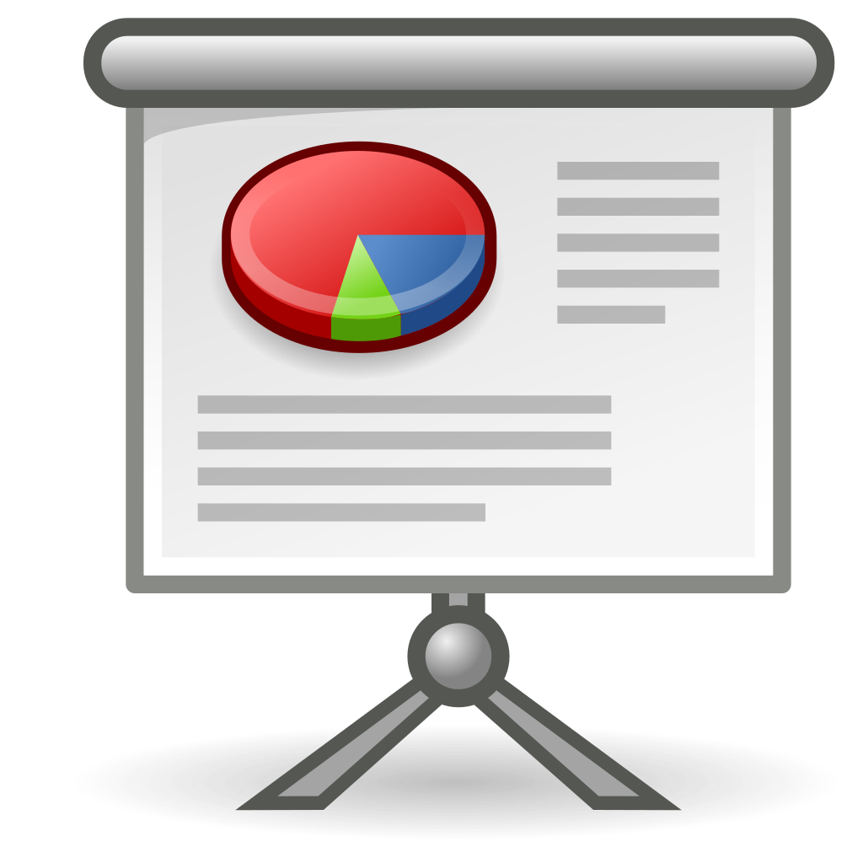

Data Analyst work
Define the objective
Data collection
Data cleaning
Data exploration
Data processing
Model training
Model validation
Present you findings

Slide 3


Slide 4


The goal of the company
Financial help
“Healthcare for All”, is a not-for-profit organization that provides financial help to people with who are not able to afford paying a healthcare insurance.
“Healthcare for All” raises funds through donations from all across the country (fund raising)
Channels:
Personal mails
Emails
Events
Reaching out to other businesses corporations, and philanthropists.
00

Slide 5

The problem
One of their most efficient channels for a long period of time has been direct mails. But for the last couple of years, they have seen a decline in the donations through this chanel

Slide 6
Role play
You are working for “Healthcare for All” as an Data Analyst.
You will be analyzing the results of one of their recent direct mail fundraising champings.
This mailing was sent to a total of 3.5 million “Healthcare for All” donors who were on the database as of June 1997.
Everyone included in this mailing had made at least one prior donation.
00

Slide 7


Target donors
LOW DONORS:
Small donation
amount
LAPSED DONORS:
Made a donation 12-24 months ago.
LAPSED DONORS are more likely to donate again
LOW DONORS can compensate for high donors
00

Slide 8
Target donors
Healthcare for All” wishes to:
Develop a model to predict the donated amount.
Minimize the losses incurred by targeting sub-optimal donors
00

Slide 9
The dataset
Two sets:
Learning dataset (to train the model):
Non respondents: 94.9%
Respondents: 5.1%
Validation set (to evaluate the model):
Non respondents: 94.9%
Respondents: 5.1%

Slide 10
Some background
Data distribution ~ 95 vs 5 (answered vs not answered)
Cost: $0.68/envelope (the cost of the envelopes)
6/97 to generate the “time since” ADATE_2
00

Slide 11
Steps as Data Analysts (I)
Define the objective: Predict the benefits that "Healthcare for All" obtains through mail donations by "Lapsed" donors.
Gather the data: In our case the data is spread across several files that will have to be merged.
Clean the data:
some empty cells
some weird entries
gender encoding
others

Slide 12
Steps as Data Analysts (II)
Explore: here we'll want to answer questions like:
group donors (by gender, by state...)
what's the distribution of donations by group
are there noticeable group differences?
Process: Here we'll start looking at what model we want to apply, and we might need to change how some columns are expressed.

Slide 13
Steps as Data Analysts (III)
Apply model: create a model to predict the donation amount of each donor
Validate: check the predictions against a little subset of the data that we'll have previously hold out.
Present: for this initial project, we won't have to present it.

